Slide 1



7 pitfalls to avoid when you’re
Pre-Approved and looking
www.msoga.com

Slide 2

You’re Preapproved... Now What?
Whether you're a first-time buyer or a seasoned pro, getting preapproved by Mortgage Solutions of Georgia is a big step in the right direction. But here’s the catch: just because you’ve got that preapproval letter in hand doesn’t mean the road to homeownership is smooth sailing. Many buyers still hit some common roadblocks, even after securing preapproval. But don’t worry - we are here to help!

Slide 3


Pitfall #1:
Changing Jobs or Income
Impact: Affects mortgage approval due to financial stability concerns.
**Tip:** Consult with our expert loan officers, Dave Tallman or Ken Forrester, before making changes.

Slide 4


Pitfall #2:
Maxing out Credit Cards
Impact: Can lower your credit score and affect loan terms.
**Tip:** Keep credit utilization below 30% and avoid new debt.

Slide 5


Pitfall #3:
Making large
purchases
Impact: Alters debt-to-income ratio, risking mortgage approval.
**Tip:** Delay major purchases until after closing.

Slide 6


Pitfall #4:
Missing Documents
Impact: Can cause delays or jeopardize loan approval.
**Tip:** Stay organized and submit documents promptly.

Slide 7


Pitfall #5:
Overestimating
your budget
Impact: Leads to financial strain and stress.
**Tip:** Create a comfortable budget considering all costs.

Slide 8
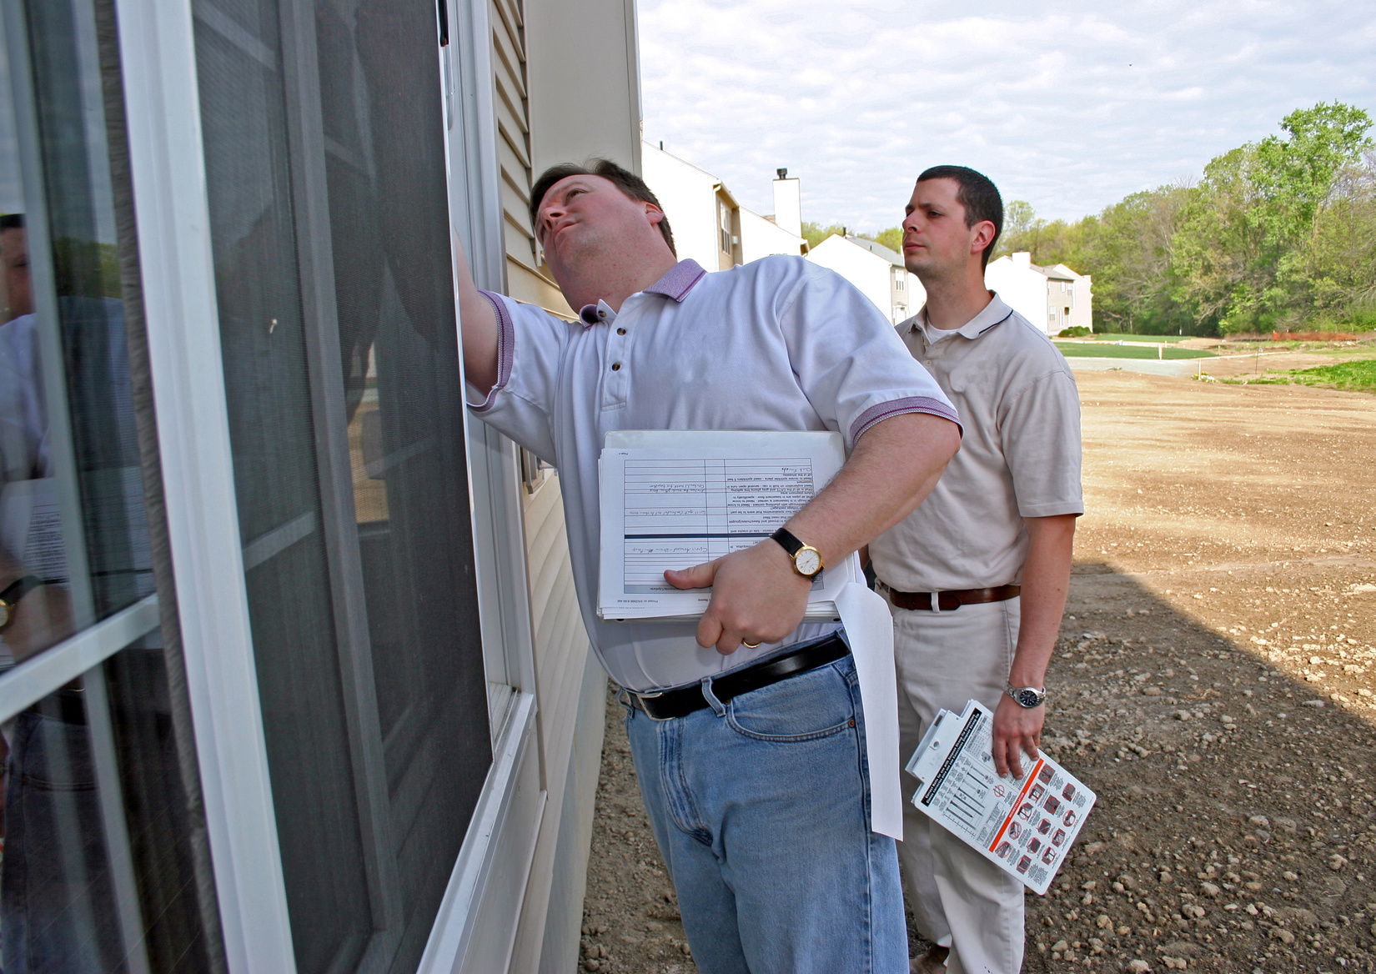

Pitfall #6:
Ignoring additional Costs
Impact: Overlooking costs like taxes and insurance can affect affordability. Also upfront costs, like appraisal and inspection fees, and of course closing costs.
**Tip:** Work with our team to understand the full financial picture.

Slide 9

Pitfall #7:
Failing to communicate with your Lender Team
Impact: Changes may require updates to your application.
**Tip:** Stay in touch with your lender for smooth processing.

Slide 10
Our teams are here to help!
Being preapproved is an exciting first step in homebuying. To ensure a smooth journey to homeownership, avoid these common pitfalls and choose Mortgage Solutions of Georgia as your trusted lender. Our experts are committed to helping you secure the best mortgage terms. For questions or guidance, contact us to schedule a consultation with our loan officers.
We're here to help you achieve your homeownership dreams!

Slide 11

Contact US
770-924-1111
4480 Park St.,
Acworth, GA 30101
MortgageSolutions@MSOGA.com

