Slide 1





Refinance
This presentation will help current homeowners understand when and why refinancing their mortgage might be beneficial.
PRESENTATION BY DAVE TALLMAN

Slide 2


Refinancing: Is it right for you?
Objective: To help current homeowners understand when and why refinancing might be beneficial.
Refinancing can be a smart financial decision, but it's essential to evaluate your individual situation.Whether you're looking to lower your monthly payments, reduce your interest rate, or access equity in your home, understanding the nuances of refinancing will empower you to make the best choice. Begin by assessing your current mortgage terms and comparing them with the prevailing market rates. Additionally, consider the length of time you plan to stay in your home, as this will influence the potential savings refinancing can offer.

Slide 3



Reasons to Refinance
LOWER INTEREST RATES
CHANGE LOAN TERMS
CASH OUT EQUITY
TAKE ADVANTAGE OF LOWER INTEREST RATES TO REDUCE MONTHLY PAYMENTS
MODIFY THE LENGTH OF YOUR LOAN FOR BETTER FINANCIAL ALIGNMENT
USE HOME EQUITY FOR RENOVATIONS, EDUCATION, OR DEBT CONSOLIDATION

Slide 4

Cost Vs. Savings
    BREAK-EVEN POINT: UNDERSTAND THE TIME IT TAKES TO RECOUP REFINANCING COSTS.
    EVALUATE SAVINGS: CALCULATE POTENTIAL SAVINGS OVER THE LOAN TERM.
    CONSIDER FEES: BE AWARE OF CLOSING COSTS AND OTHER FEES ASSOCIATED WITH REFINANCING.

Slide 5





Process Overview
APPLICATION
APPRAISAL
APPROVAL & CLOSING
SIMILAR TO THE INITIAL MORTGAGE PROCESS WITH UPDATED DOCUMENTATION
A NEW PROPERTY APPRAISAL MAY BE REQUIRED
UNDERSTANDING THE TIMELINE FROM APPROVAL TO CLOSING

Slide 6



Initial Mortgage Vs. Refinance
    DOCUMENTATION: DIFFERENCES AND SIMILARITIES IN REQUIRED PAPERWORK.
    TIMELINE: HOW REFINANCING COMPARES IN DURATION TO THE INITIAL MORTGAGE.
    COSTS: COMPARE THE UPFRONT COSTS OF BOTH PROCESSES.

Slide 7

Is it right for YOU?
PERSONAL FINANCIAL GOALS: ALIGN REFINANCING WITH LONG-TERM OBJECTIVES.
TIMING CONSIDERATIONS: ASSESS THE BEST TIME TO REFINANCE BASED ON MARKET CONDITIONS.
RISK ASSESSMENT: WEIGH THE PROS AND CONS SPECIFIC TO YOUR SITUATION.

Slide 8
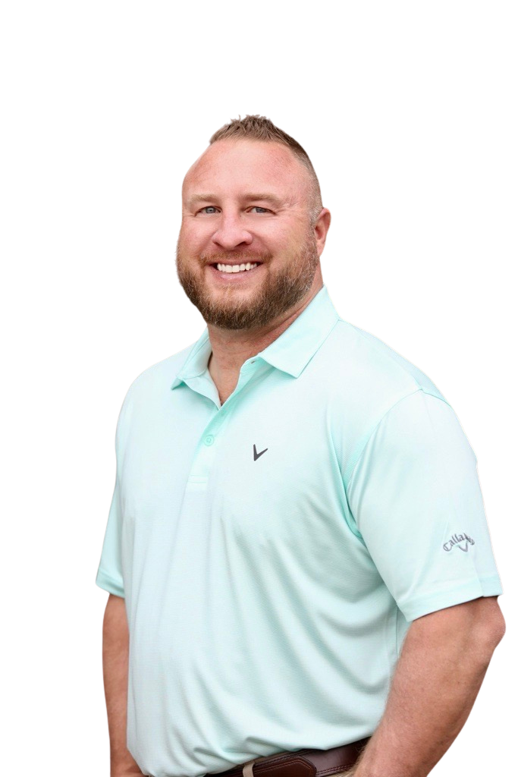




Contact Us
770.924.1111
Dave Tallman, CEO/Owner
Mortgage Loan Expert
www.msoga.com
4480 Park St., Acworth, GA 30101
131 E. Jackson St., Thomasville, GA 31792
MortgageSolutions@MSOGA.com

